Slide 1
Causal Inference: Heterogeneous Treatment Effect Models
Julian Hsu (@hsujulia)
Delivery Experience (DEX) Economics
You can find these slides here and accompanying notebook here.

Slide 2
Overview
Use cases for heterogeneous treatment effects (HTE) models.
Additional challenges compared to non-HTE models
Showcase a few families of HTE models:
T-Learners and X-Learners
OLS and DML
ML-driven weights: GRF
Conclude with some recommendations and best practices.
Other HTE presentations at Amazon:
Common Mistakes in Estimating Treatment Effects: Heterogeneous and otherwise (@duncang / @yuwhsieh / @dizeng)
CATE Meta Learners (@shyurya)

Slide 3
When do we care about heterogeneous treatment effects (HTE) ?
Making universal policies are not good use cases:
Product return policies
Product pricing
Making targeted policies or taking customized actions are good use cases:
Which customers should be defaulted to faster delivery options?
How do we match sellers with the best support or representatives?
Which customers spend more when we expand ASIN selection?
Which orders should we delay so we can scrutinize them for fraud evaluation?

Slide 4
Inferring causality
Just like non-HTE causal use cases, like Average Treatment Effect (ATE) or Average Treatment Effect on the Treated (ATET), HTE remains a causal question.
The problem is that we do not observe outcomes under both the treatment and control conditions.
Let’s briefly review how we get around this problem in cross-sectional data
 | Outcome if they were control? | Outcome if they were treated?
Control Units | Observed | Not Observed
Treated Units | Not Observed | Observed

Slide 5
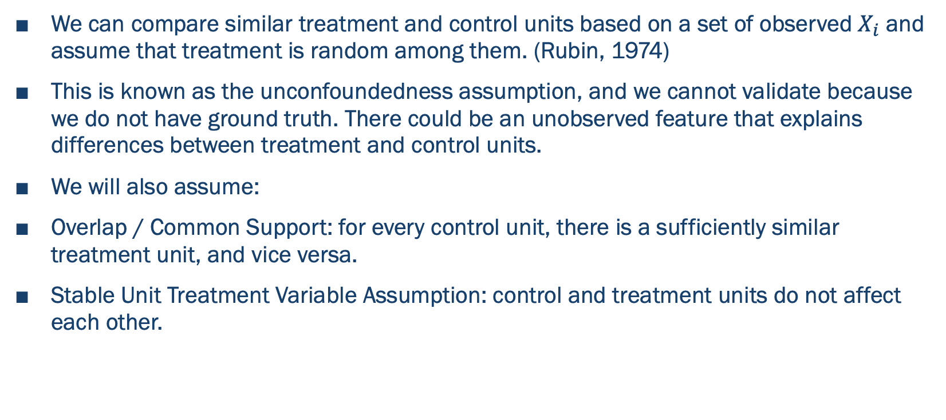
Finding the mini-experiments in your non-experimental data
We can compare similar treatment and control units based on a set of observed $X_{i}$ and assume that treatment is random among them. (Rubin, 1974)
This is known as the unconfoundedness assumption, and we cannot validate because we do not have ground truth. There could be an unobserved feature that explains differences between treatment and control units.
We will also assume:
Overlap / Common Support: for every control unit, there is a sufficiently similar treatment unit, and vice versa.
Stable Unit Treatment Variable Assumption: control and treatment units do not affect each other.

Slide 6
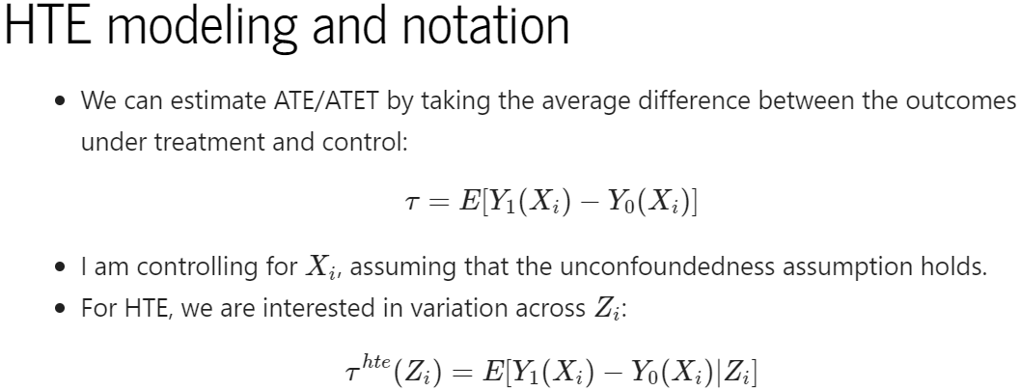

HTE Modeling and Notation
We can estimate ATE by taking the average difference between the predicted outcomes under treatment and control:
Under the unconfoundedness assumption, controlling for $X_{i}$ gets us an unbiased causal estimate.
For HTE, we are interested in variation across $Z_{i}$:

Slide 7
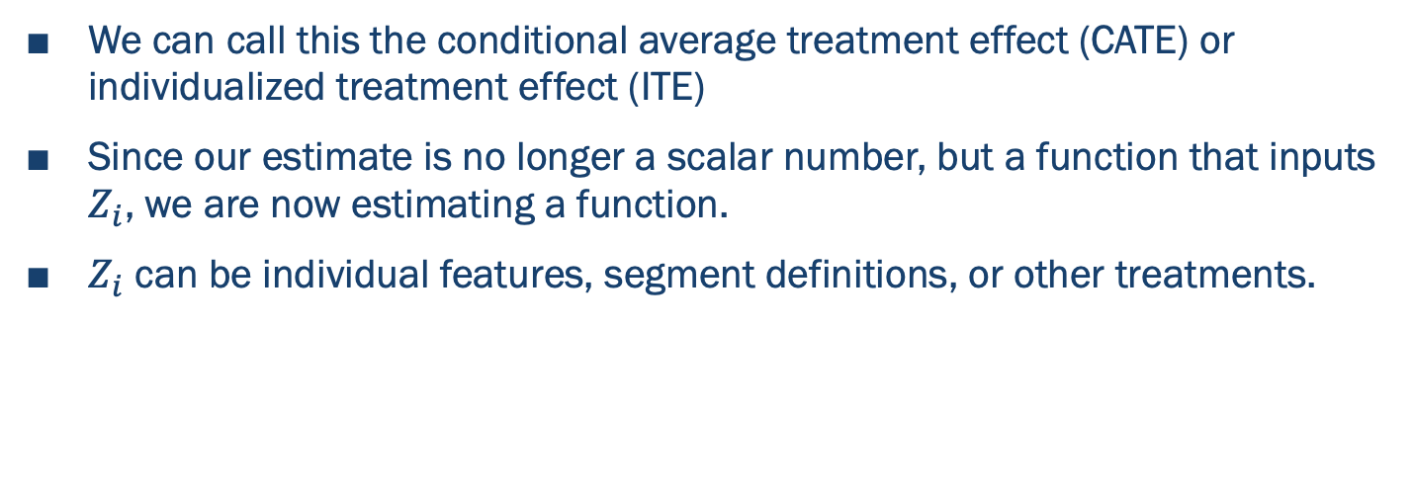
HTE Interpretations
We can call this the conditional average treatment effect (CATE) or individualized treatment effect (ITE)
Since our estimate is no longer a scalar number, but a function that inputs $Z_{i}$, we are now estimating a function.
$Z_{i}$ can be individual features, segment definitions, or other treatments.

Slide 8
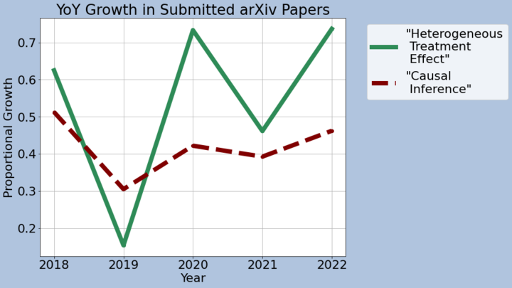
Some HTE Models
This is a very active literature, so consider this a brief summary of broad classes

Slide 9
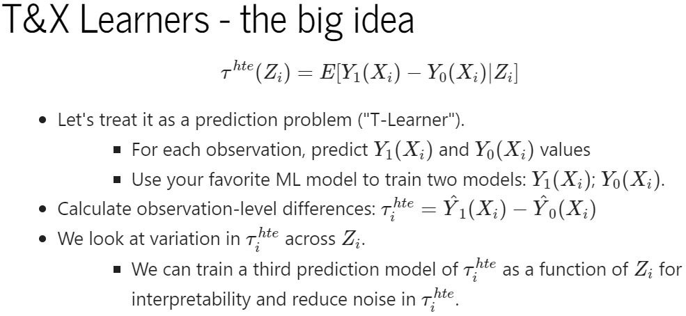

Slide 10
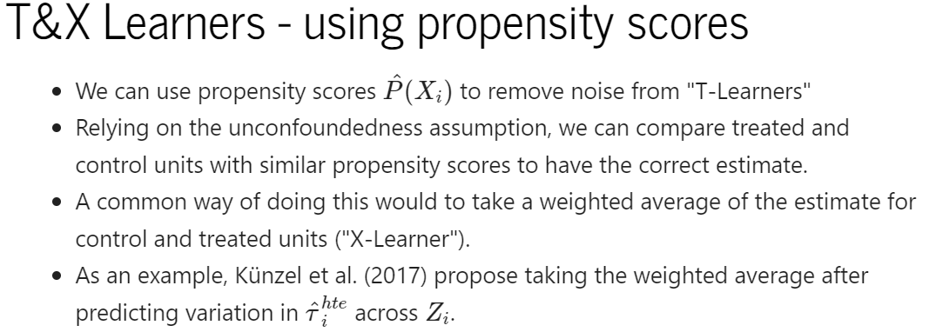
Notes:
Justify here why we should be using Propensity score Models

Slide 11
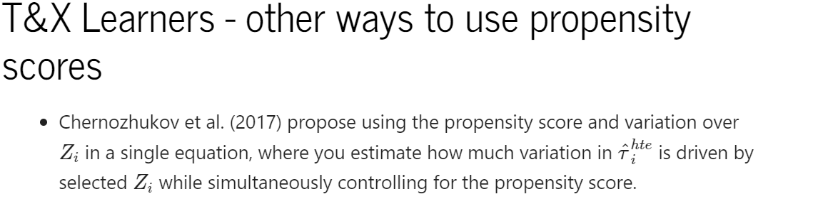
Here at Amazon...
Perfect Order Experience (POE) team uses Orthogonal Signal Smoothing to flexibility predict variation in HTE while maintaining interpretability ( paper and wiki ). (POCs: @dizeng, @chhrajul)
Ads Economics uses Gaussian processes to estimate counterfactual models (paper and poster ), using them to measure the DSI of completing queries at the advertiser level ( wiki and paper ). (POC: @grezgerm)
Ads Economics estimates HTE ads incrementality by estimating Probability of Treatment given Outcome (POT) and leverages Bayes rule (paper). (POC: @shyurya)

Slide 12
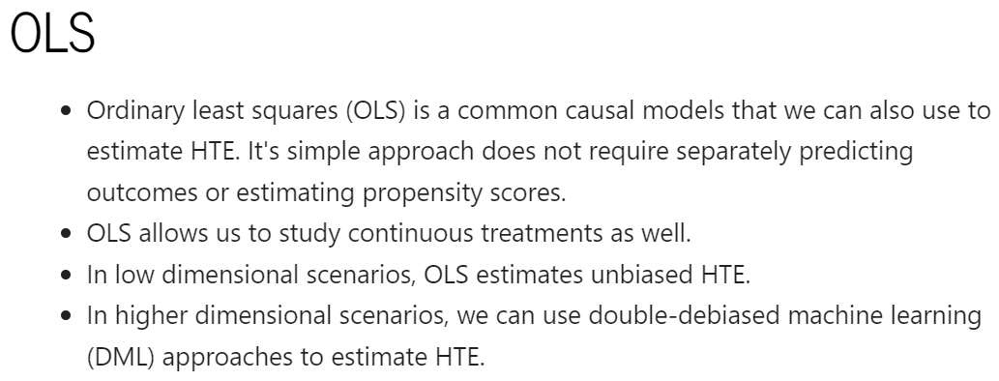

Slide 13
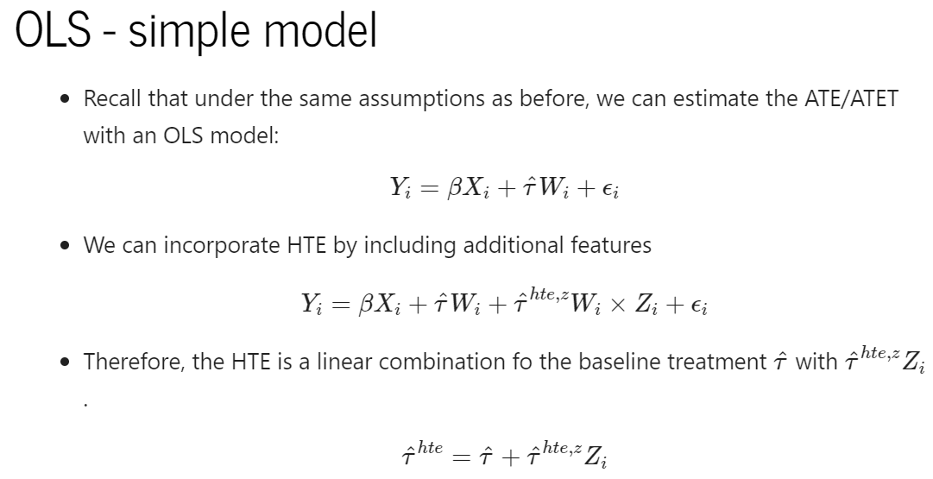

Slide 14
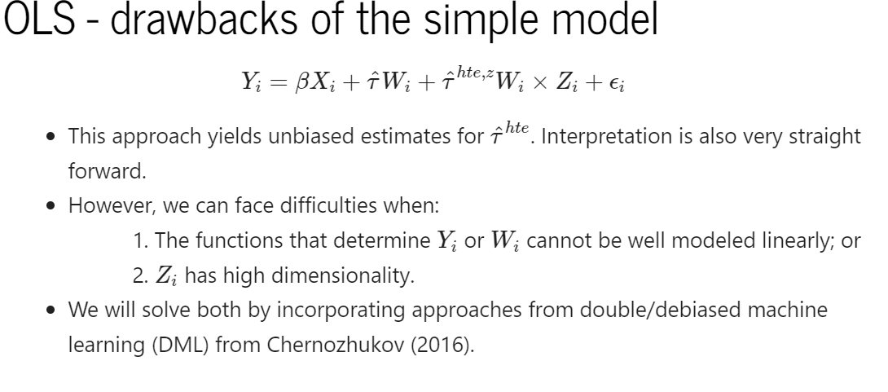

Slide 15
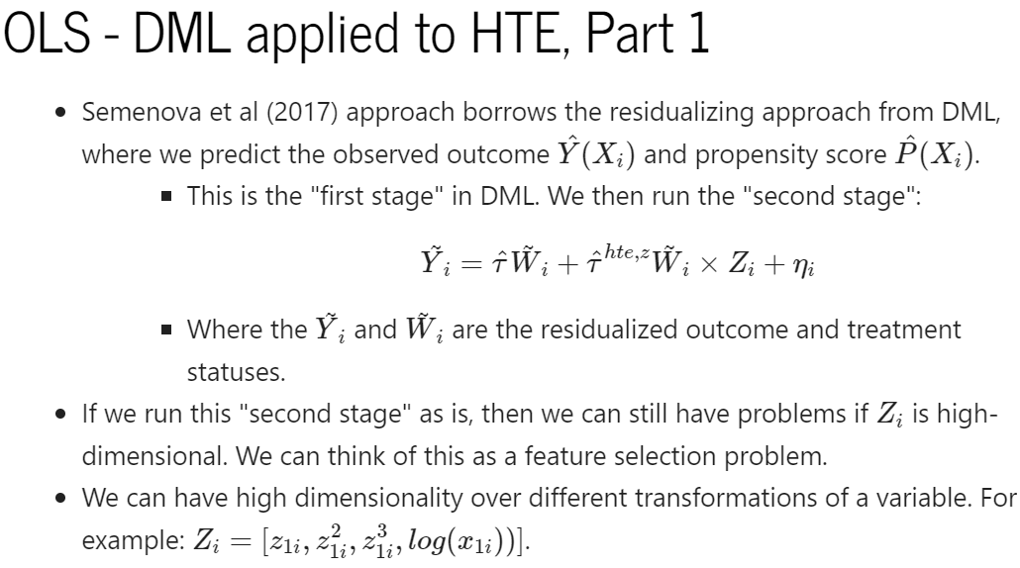

Slide 16
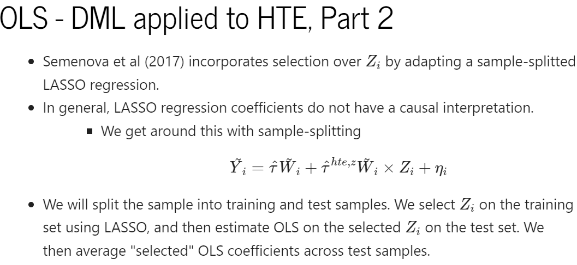

Slide 17
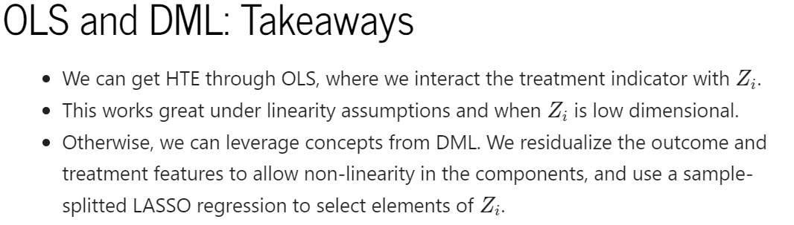
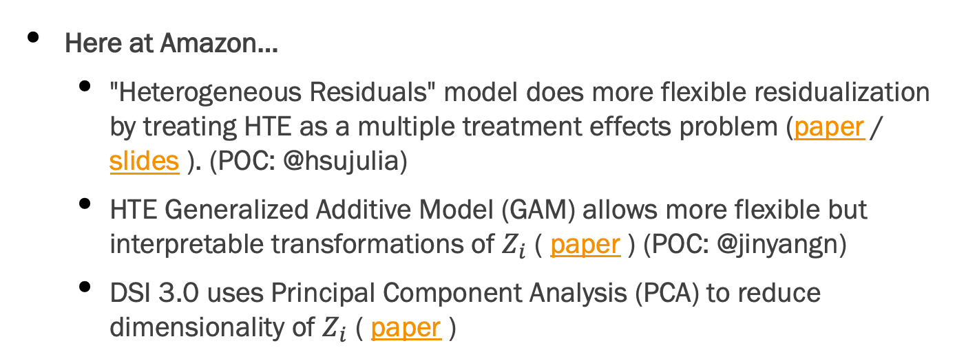
Here at Amazon...
"Heterogeneous Residuals" model does more flexible residualization by treating HTE as a multiple treatment effects problem (paper / slides ). (POC: @hsujulia)
HTE Generalized Additive Model (GAM) allows more flexible but interpretable transformations of $Z_{i}$ ( paper ) (POC: @jinyangn)
DSI 3.0 uses Principal Component Analysis (PCA) to reduce dimensionality of $Z_{i}$ ( paper )

Slide 18
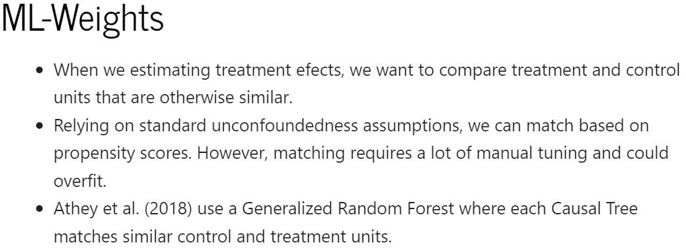

Slide 19
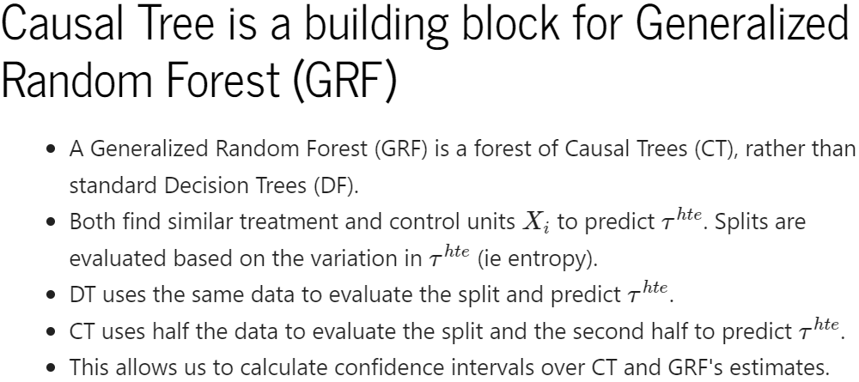

Slide 20
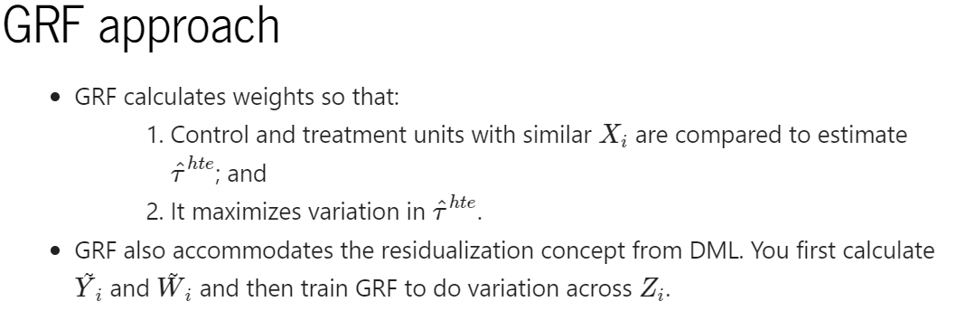
Here at Amazon...
Localized DSI through the Pareto tool uses K-means clustering with kernel methods to form clusters rather than a forest approach ( paper / website ) (POC: @ywenting)
CIV estimates HTE using a similar forest approach (CIV Review in 2020 Doc). (POC: @sufangli)

Slide 21
Other HTE Applications Across Amazon
We can apply HTE to DSE-style surrogate models to predict long-term impacts. (HTE DSE Models paper ) (POC: @yaxic)
HTE models can also be applied to panel models. CIV application (POC: @gitalo)
Heterogeneous Treatment Effects in Difference-in-Difference Designs (POC: @phsant).

Slide 22
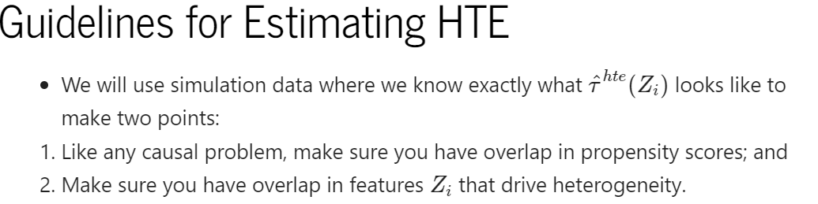

Slide 23
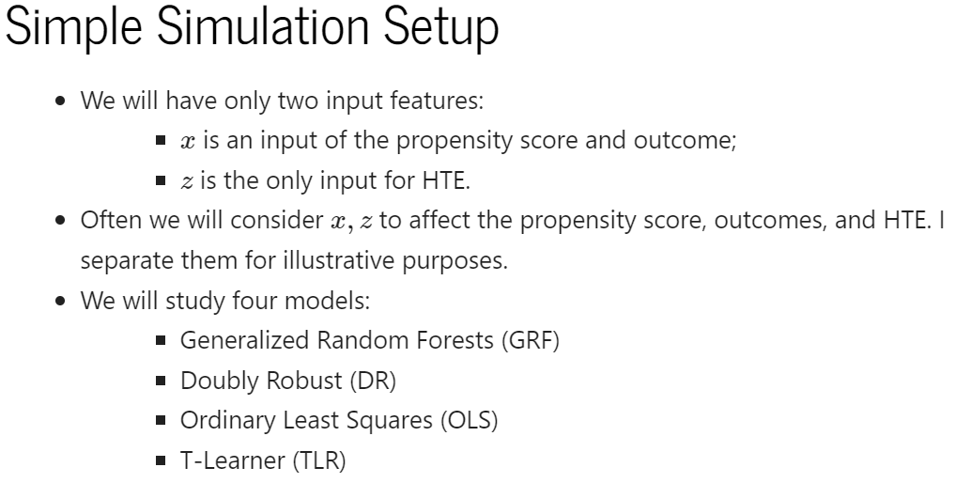

Slide 24
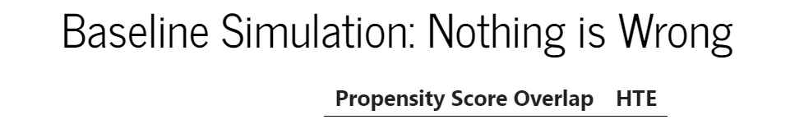
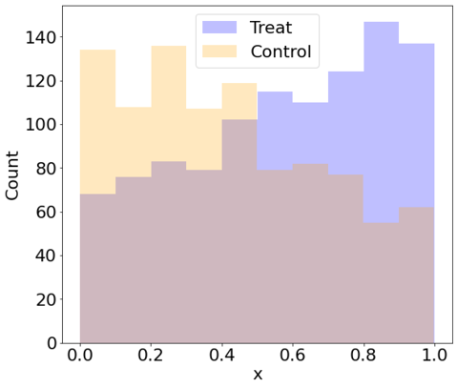
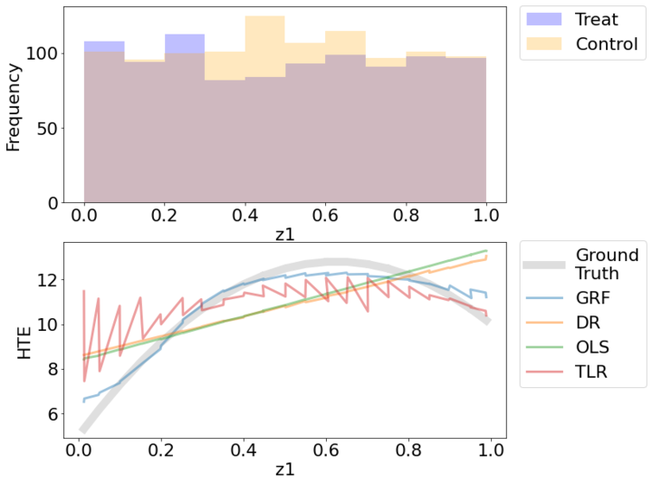
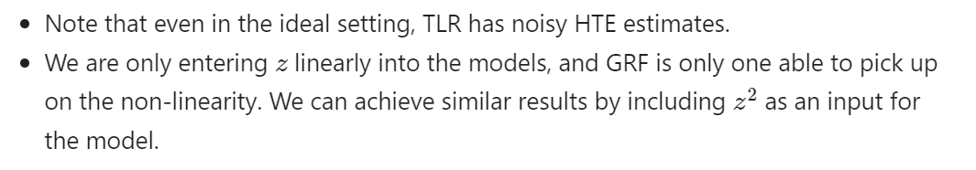

Slide 25
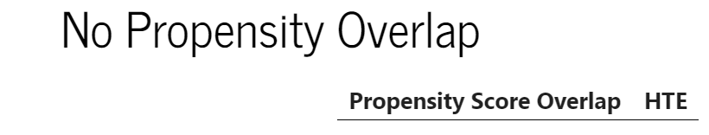
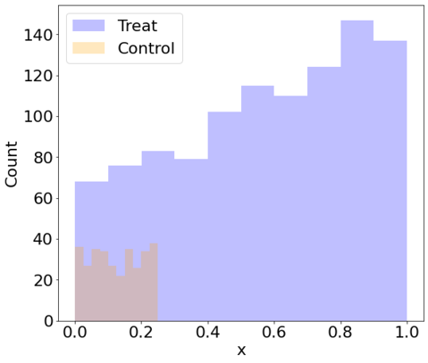
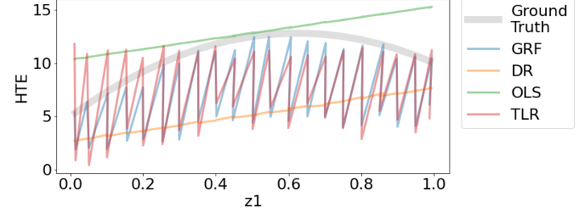


Slide 26

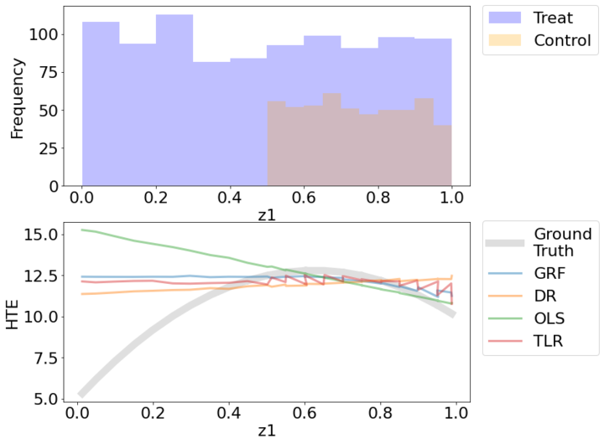
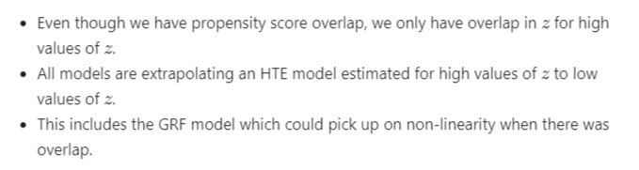

Slide 27
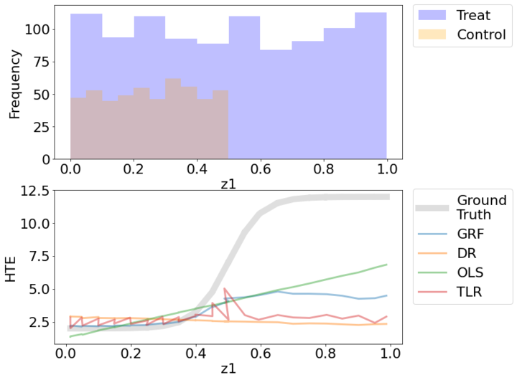
No HTE overlap means you are extrapolating HTE is a Logit Function

Slide 28
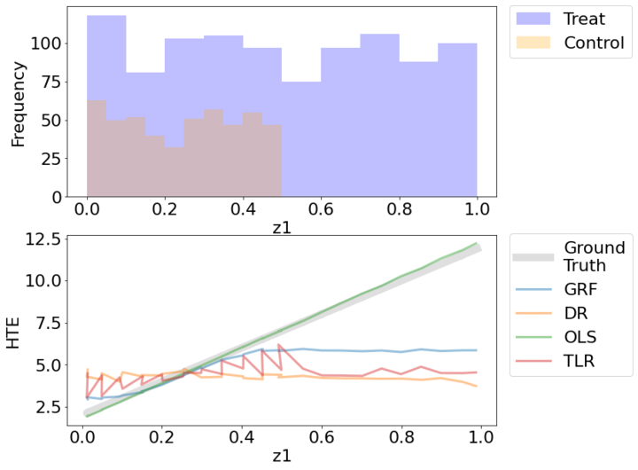
No HTE overlap means you are extrapolating HTE is a Linear Function

Slide 29

Conclusion
Showed that HTE problems are still causal problems, where we do not observe ground truth.
We should always make sure we have a valid design to estimating the average causal estimate before looking for HTE.
HTE also requires sufficient coverage in dimensions of heterogeneity.
Briefly overviewed some HTE models: T-Learners, X-Learners, OLS, DML, and GRF
Thank you and happy modeling running! (@hsujulia)

Slide 30
Thank You For Viewing!

Slide 31
Papers: T&X Learners
Künzel, Sekhon, Bickel, Yu. Meta-learners for estimating heterogeneous treatment effects using machine learning http://arxiv.org/abs/1706.03461
Semenova, Chernozhukov. Debiased Machine Learning of Conditional Average Treatment Effects and Other Causal Functions https://arxiv.org/abs/1702.06240
Chernozhukov, Demirer, Duflo, Fernández-Val. Generic Machine Learning Inference on Heterogenous Treatment Effects in Randomized Experiments https://arxiv.org/abs/1712.04802
Kennedy. Towards optimal doubly robust estimation of heterogeneous causal effects https://arxiv.org/abs/2004.14497
Sant'Anna, Zhao Doubly Robust Difference-in-Differences Estimators https://arxiv.org/abs/1812.01723

Slide 32
Papers: OLS and DML
Chernozhukov, Chetverikov, Demirer, Duflo, Hansen, Newey, Robins. Double/Debiased Machine Learning for Treatment and Causal Parameters https://arxiv.org/abs/1608.00060
Semenova, Goldman, Chernozhukov, Taddy. Estimation and Inference on Heterogeneous Treatment Effects in High-Dimensional Dynamic Panels under Weak Dependence https://arxiv.org/abs/1712.09988

Slide 33
Papers: ML-Weights
Athey, Tibshirani, Wager. Generalized Random Forests https://arxiv.org/abs/1610.01271
Friedberg, Tibshirani, Athey, Wager. Local Linear Forests https://arxiv.org/abs/1807.11408
Wager, Athey. Estimation and Inference of Heterogeneous Treatment Effects using Random Forests https://arxiv.org/abs/1510.04342
Farrell, Liang, Misra. Deep Neural Networks for Estimation and Inference https://arxiv.org/abs/1809.09953

